Slide 1
Tropospheric O₃ formation
and its impact at plants

Slide 2
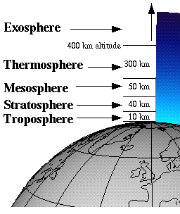
Ozone in atmosphere
Tropospheric Ozone: Ozone present from ground tp 10 Km
Stratospheric Ozone: Ozone present from 10 Km to 50 Km

Slide 3
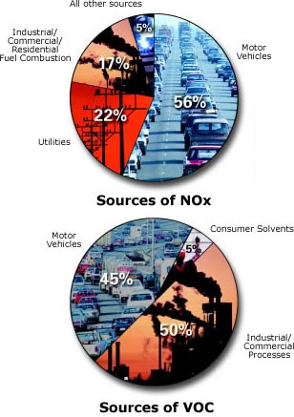

Sources of Ground-Level Ozone
NOx, VOC + sunlight
Ozone
Hot
sunny
days
Notes:
Ground-level or "bad" ozone is not emitted directly into the air, but is created by chemical reactions between oxides of nitrogen (NOx) and volatile organic compounds (VOC) in the presence of sunlight. Emissions from industrial facilities and electric utilities, motor vehicle exhaust, gasoline vapors, and chemical solvents are some of the major sources of NOx and VOC.
At ground level, ozone is a harmful pollutant. Ozone pollution is a concern during the summer months because strong sunlight and hot weather result in harmful ozone concentrations in the air we breathe. Many urban and suburban areas throughout the United States have high levels of "bad" ozone. But many rural areas of the country are also subject to high ozone levels as winds carry emissions hundreds of miles away from their original sources.

Slide 4
What is tropospheric ozone and why are we Interested in it?
Pollution:
O₃ is an important component of photochemical smog
Climate:
Direct: O₃ is a greenhouse gas
Tropospheric oxidation:
O₃ regulates oxidation through control of OH and VOCs, etc.
Anthropogenic Influence:
Surface and Tropospheric O₃ is increasing due to human activity
Environmental impacts on local, regional and global scales
Secondary pollutant: sensitive to many variables
  Chemical production can be fast in polluted conditions
  Lifetime is sufficiently long for global-scale transport

Slide 5
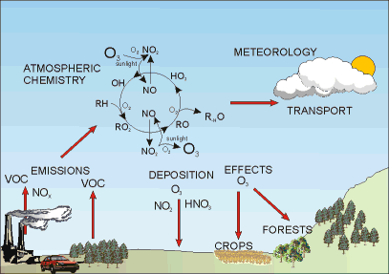
Ozone formation in troposphere
Ground level ozone is called tropospheric ozone.
How tropospheric ozone is produced in atmosphere?
Hydroxyl radical (OH) react with CO, which then quickly reacts with O₂ to give a peroxy radical (HO₂).
OH + CO → H + CO₂
H + O₂ → HO₂
The peroxy radicals then react with nitric oxide (NO) to form nitrogen dioxide (NO₂), and NO₂ in the presence of light (hν) can split into the NO and O molecules, which ultimately react with O2 to form ozone (O₃).
HO₂ + NO → OH + NO₂
NO2 + hν → NO + O
O + O₂ → O₃

Slide 6
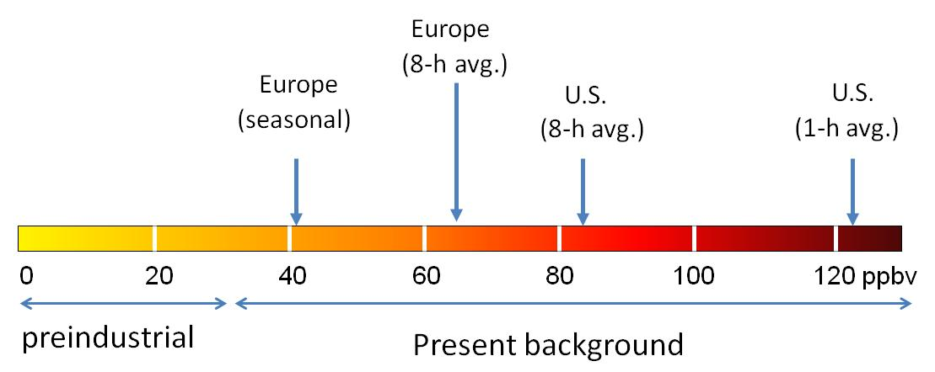
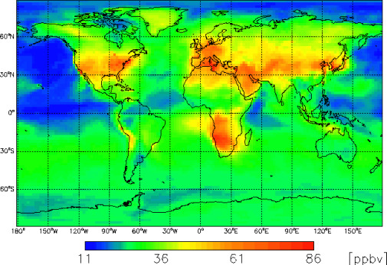
Present concentration of ozone in troposphere
Threshhold level of O₃ = 40ppb

Slide 7
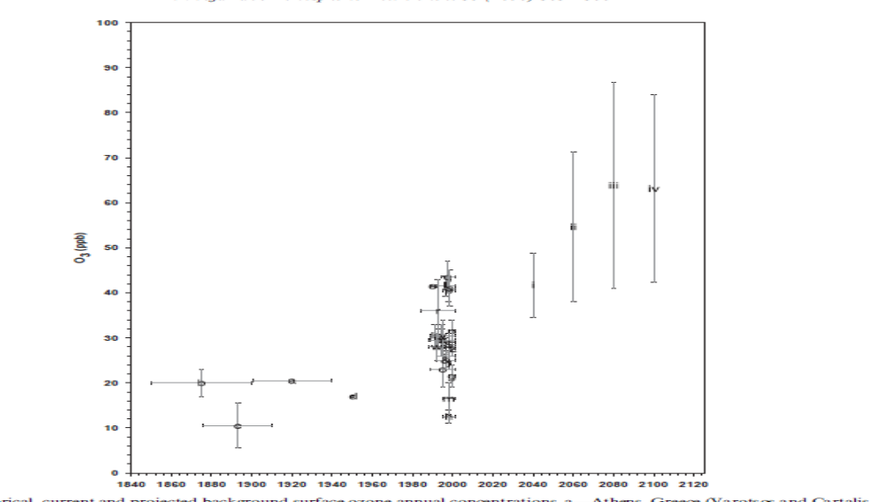
Tropospheric ozone concentrations in Future
Ozone concentration in troposphere 1840- 2100
(Vingarzan, 2004).

Slide 8
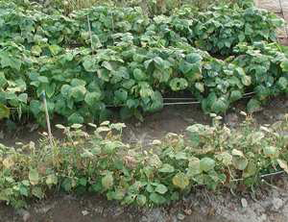
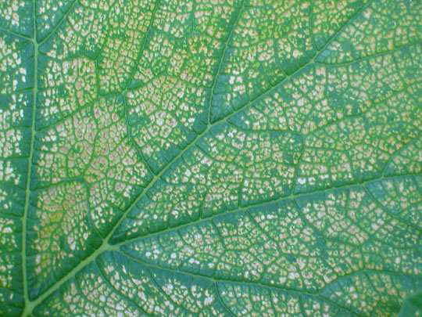
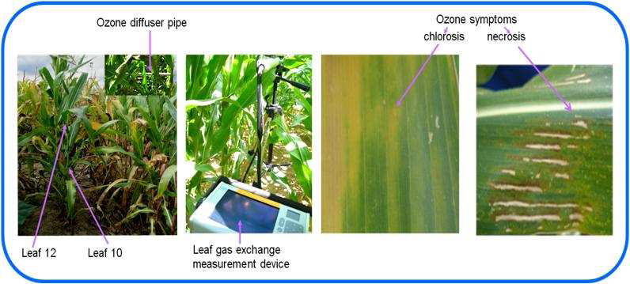
Ozone symptoms
Bean
Pumpkin

Slide 9
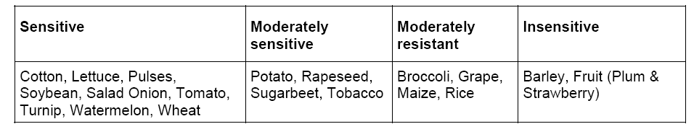
Crops classification on the basis of ozone

Slide 10
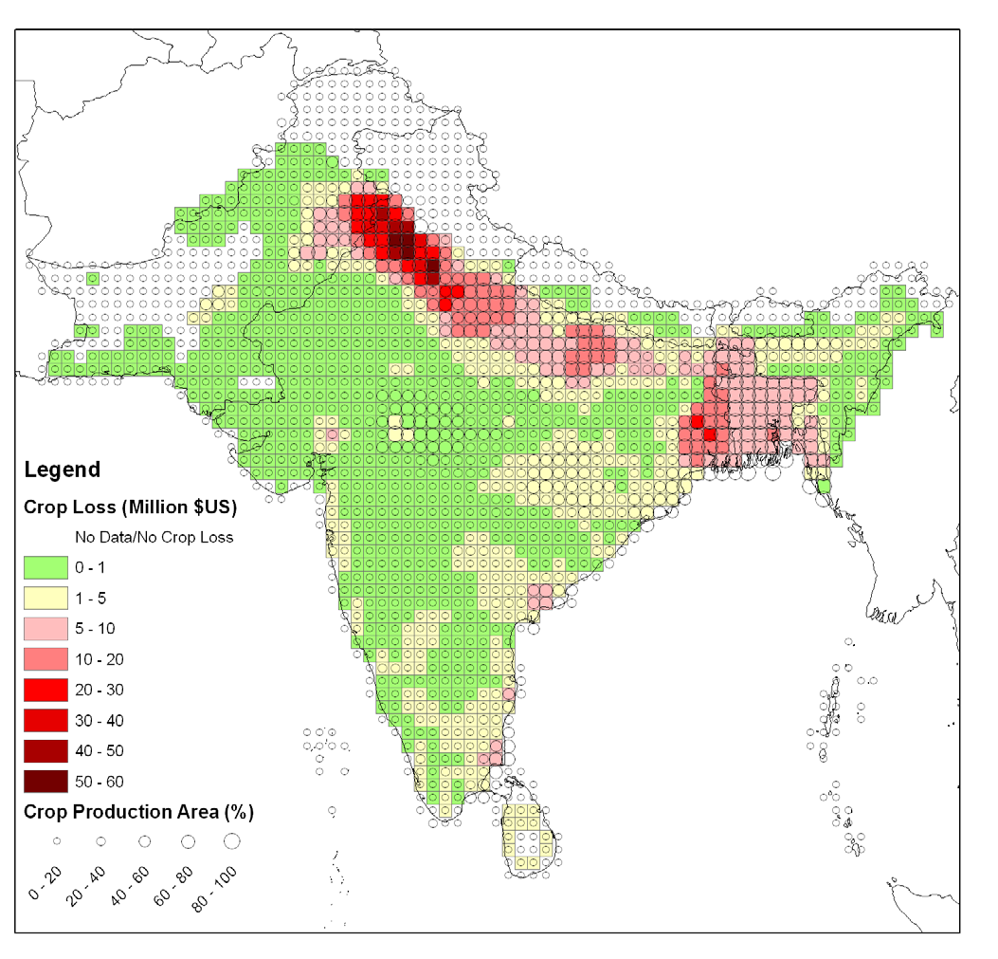
Provisional estimates of economic crop losses due to O₃ for South Asia
Mills et al., 2007

Slide 11
Effects of "Bad" Ozone
Human Health
  Coughing, throat irritation, lung damage
  Worse when working or exercising outdoors
The Environment
  Damages vegetation and ecosystems
  Increases susceptibility of trees to other stresses (pests, diseases, weather extremes)
  Forest and crop losses
Notes:
Breathing ozone can trigger a variety of health problems including chest pain, coughing, throat irritation, and congestion. It can worsen bronchitis, emphysema, and asthma. "Bad" ozone also can reduce lung function and inflame the linings of the lungs. Repeated exposure may permanently scar lung tissue.
Healthy people also experience difficulty breathing when exposed to ozone pollution. Because ozone forms in hot weather, anyone who spends time outdoors in the summer may be affected, particularly children, outdoor workers and people exercising. Millions of Americans live in areas where the national ozone health standards are exceeded.
Ground-level or "bad" ozone also damages vegetation and ecosystems. It leads to reduced agricultural crop and commercial forest yields, reduced growth and survivability of tree seedlings, and increased susceptibility to diseases, pests and other stresses such as harsh weather. In the United States alone, ground-level ozone is responsible for an estimated $500 million in reduced crop production each year. Ground-level ozone also damages the foliage of trees and other plants, affecting the landscape of cities, national parks and forests, and recreation areas.
What Is Being Done About "Bad" Ozone?
Under the Clean Air Act, EPA has set protective health-based standards for ozone in the air we breathe. EPA, state, and cities have instituted a variety of multi-faceted programs to meet these health-based standards. Throughout the country, additional programs are being put into place to cut NOx and VOC emissions from vehicles, industrial facilities, and electric utilities. Programs are also aimed at reducing pollution by reformulating fuels and consumer/commercial products, such as paints and chemical solvents, that contain VOC. Voluntary programs also encourage communities to adopt practices, such as carpooling, to reduce harmful emissions.

Slide 12
Impacts on Plants & Ecosystems
Climate Change
temperature
air pollution
carbon dioxide
ozone
Ecosystem Function
plant growth
nutrient cycling
carbon sequestration

Slide 13
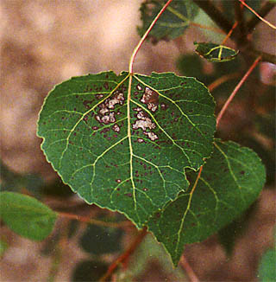
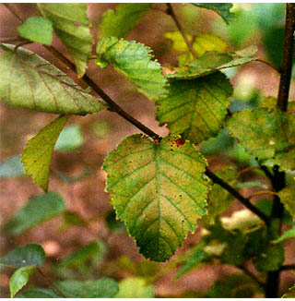
CO₂ and Ozone Effects
CO₂ effects:
+ photosynthesis
+ growth
+ water use efficiency
O₃ effects:
– photosynthesis
– growth
+ leaf senescence
Notes:
Bifacial chlorosis and bleaching of leaves were the most common foliar symptoms of O3 on paper birch (right). Premature senescence of leaves was also recorded for both aspen and birch. No symptoms were seen on sugar maple, which is O3 tolerant. Trees in elevated CO2 + O3 had significantly less visible symptoms than did trees in elevated O3, suggesting that CO2 was compensating for the adverse O3 effects.

Slide 14
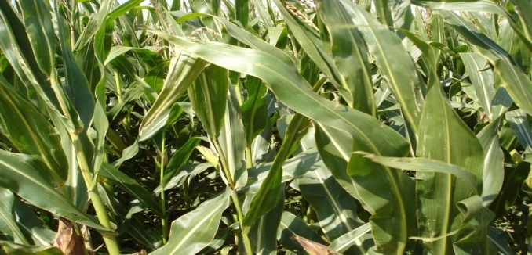
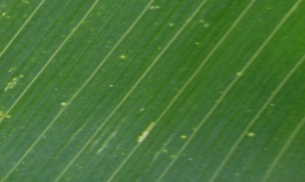
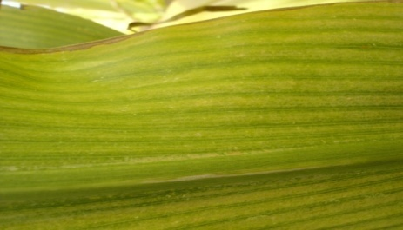
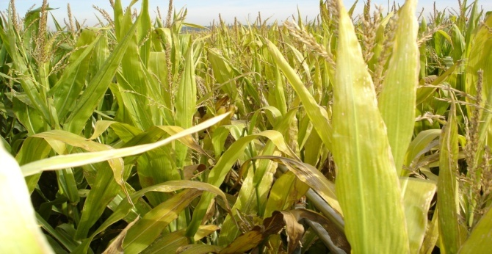
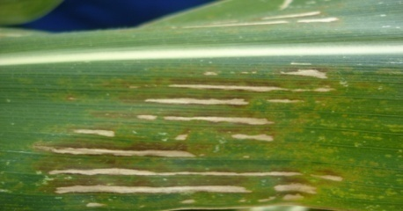
Ozone Symptoms
Control plants
chlorosis
Ozone Fumigated plants
Necrosis
Chlorosis is the appearance of yellow spots on leaves. It occurs due to the lack of chlorophylls. In contrast, necrosis is the appearance of brown spots on leaves due to death of plant cells or tissues.

